Slide 1
PyCharm Debugger

Slide 2
Introduction
A computer program will always do what you tell it to,
BUT,
What you tell the program to do might not be the same as
what you want it to do.

Slide 3
A Bug is an error or problem in a computer program

Slide 4
Different bug types:
Syntax error:
The code is not written in a proper Python language.
Runtime error:
Happens while the program is running. (for example: division by zero)
Semantic error:
The code is not doing what we intended it to do.

Slide 5
Different bug types:
Syntax error:
The code is not written in a proper Python language.
Program will not run.
Runtime error:
Happens while the program is running. (for example: division by zero)
Program runs until it reaches the error & crashes.
Semantic error:
The code is not doing what we intended it to do.
Program appears to work fine.

Slide 6
Different bug types:
Syntax error:
The code is not written in a proper Python language.
Program will not run.
Runtime error:
Happens while the program is running. (for example: division by zero)
Program runs until it reaches the error & crashes.
Semantic error:
The code is not doing what we intended it to do.
Program appears to work fine. THE TRICKIEST TO FIX

Slide 7
Possible semantic errors:
Functions are not called when they are supposed to be
Functions are called too many times
Wrong loop condition so it loops the wrong number of times
An infinite loop
And many many more

Slide 8
A Debugger
A program that lets you step through your code one line at a time & shows what values are stored in all of the variables.
We will focus on PyCharm debugger, but all debuggers have the same main features.

Slide 9
Debugger main features:
Step (over/into/out…):
Allows us to step through our code line by line.
Break points:
Allow our program to run & stop at a specific line, without executing it.
Watches:
Allow us to watch any specific variable.

Slide 10
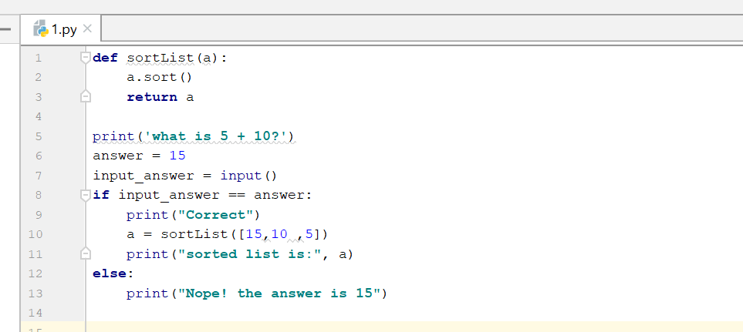
Let’s see how this works
What is the bug in this program?

Slide 11
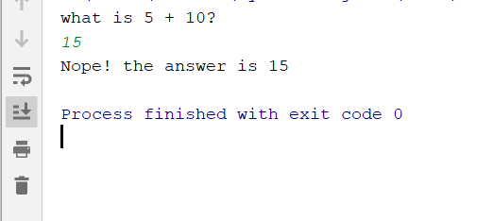
After running this program we get:
Lets try to understand why.

Slide 12
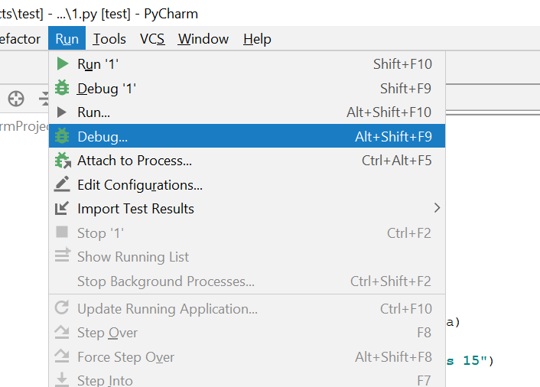
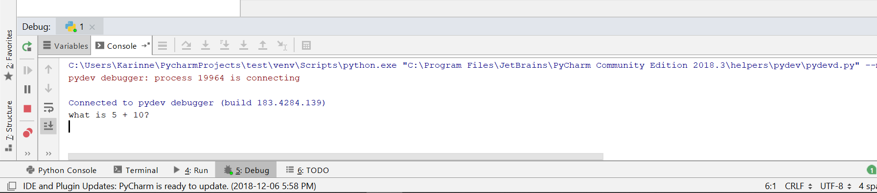
Start debug
Debug tool window

Slide 13
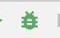
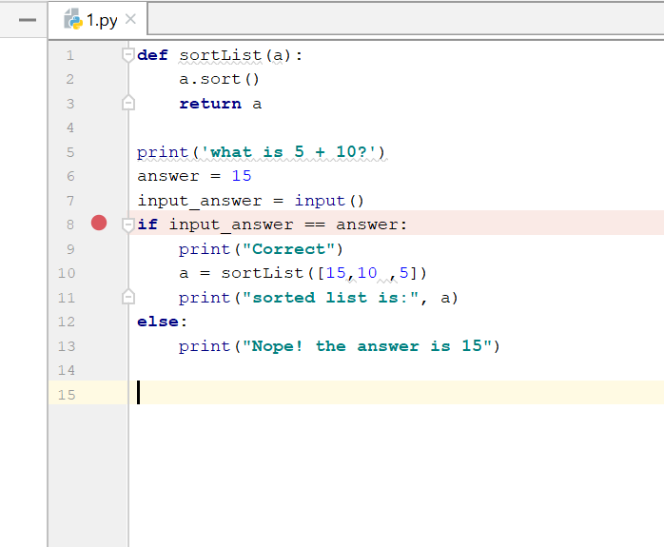
Add a break point by clicking in the left gutter and press on debug

Slide 14
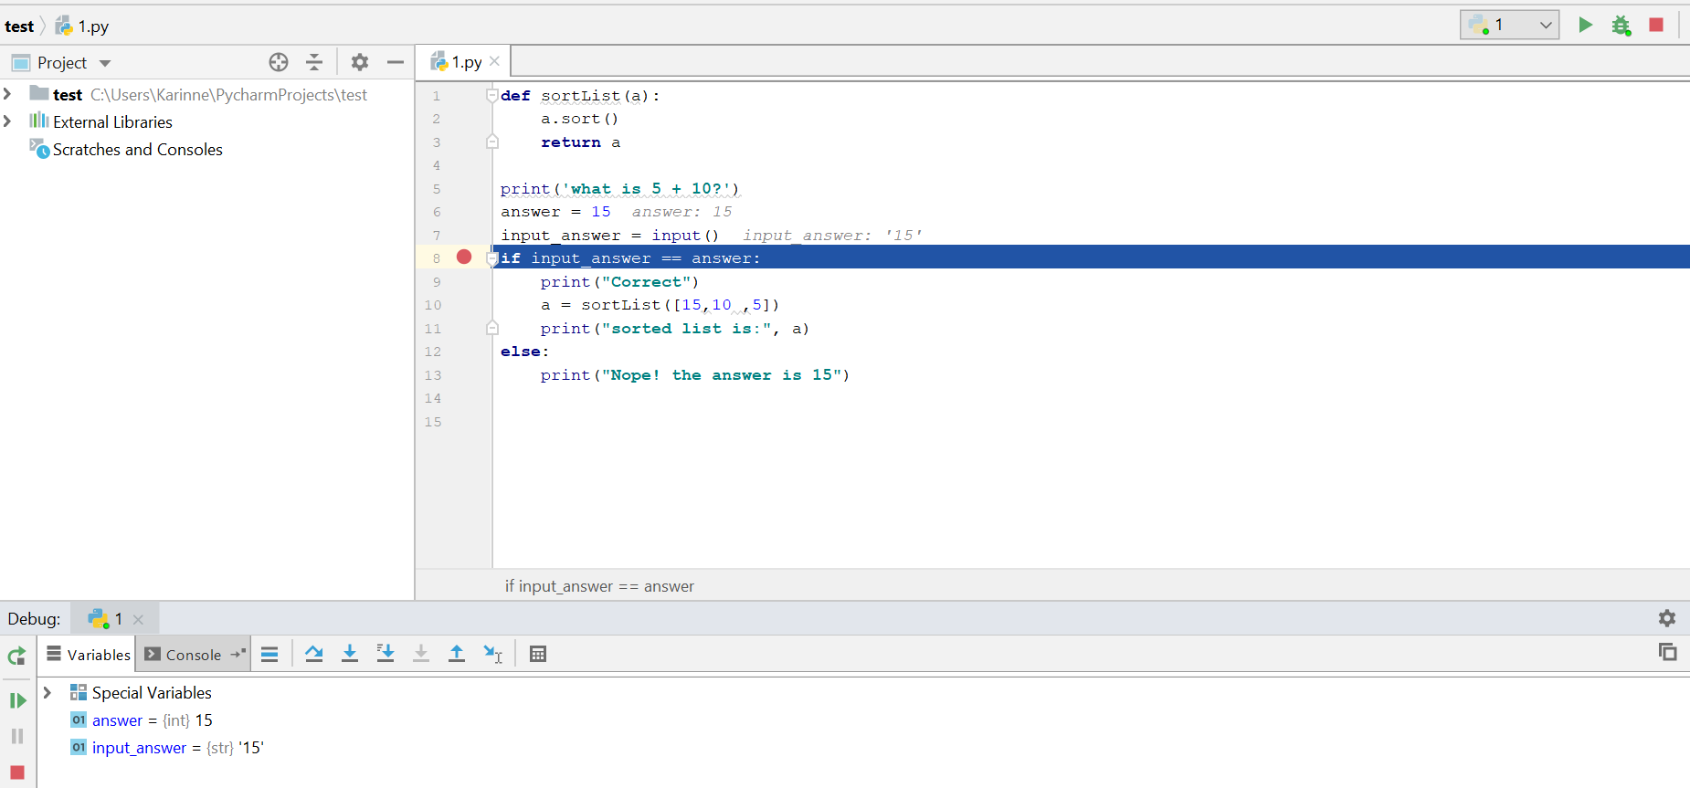
The program runs until it reaches the break point (highlights line in blue)
Variables, their types & values

Slide 15
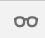
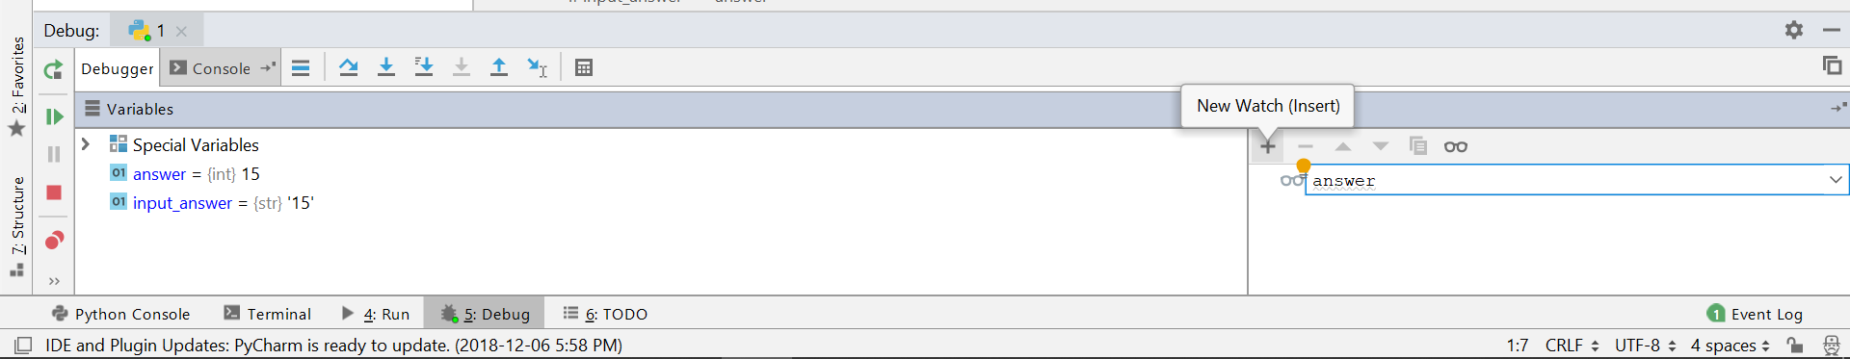
Open watches window by clicking on Then create new watches by clicking on the + sign (can be helpful when we have many variables & are only interested in values of a few)

Slide 16
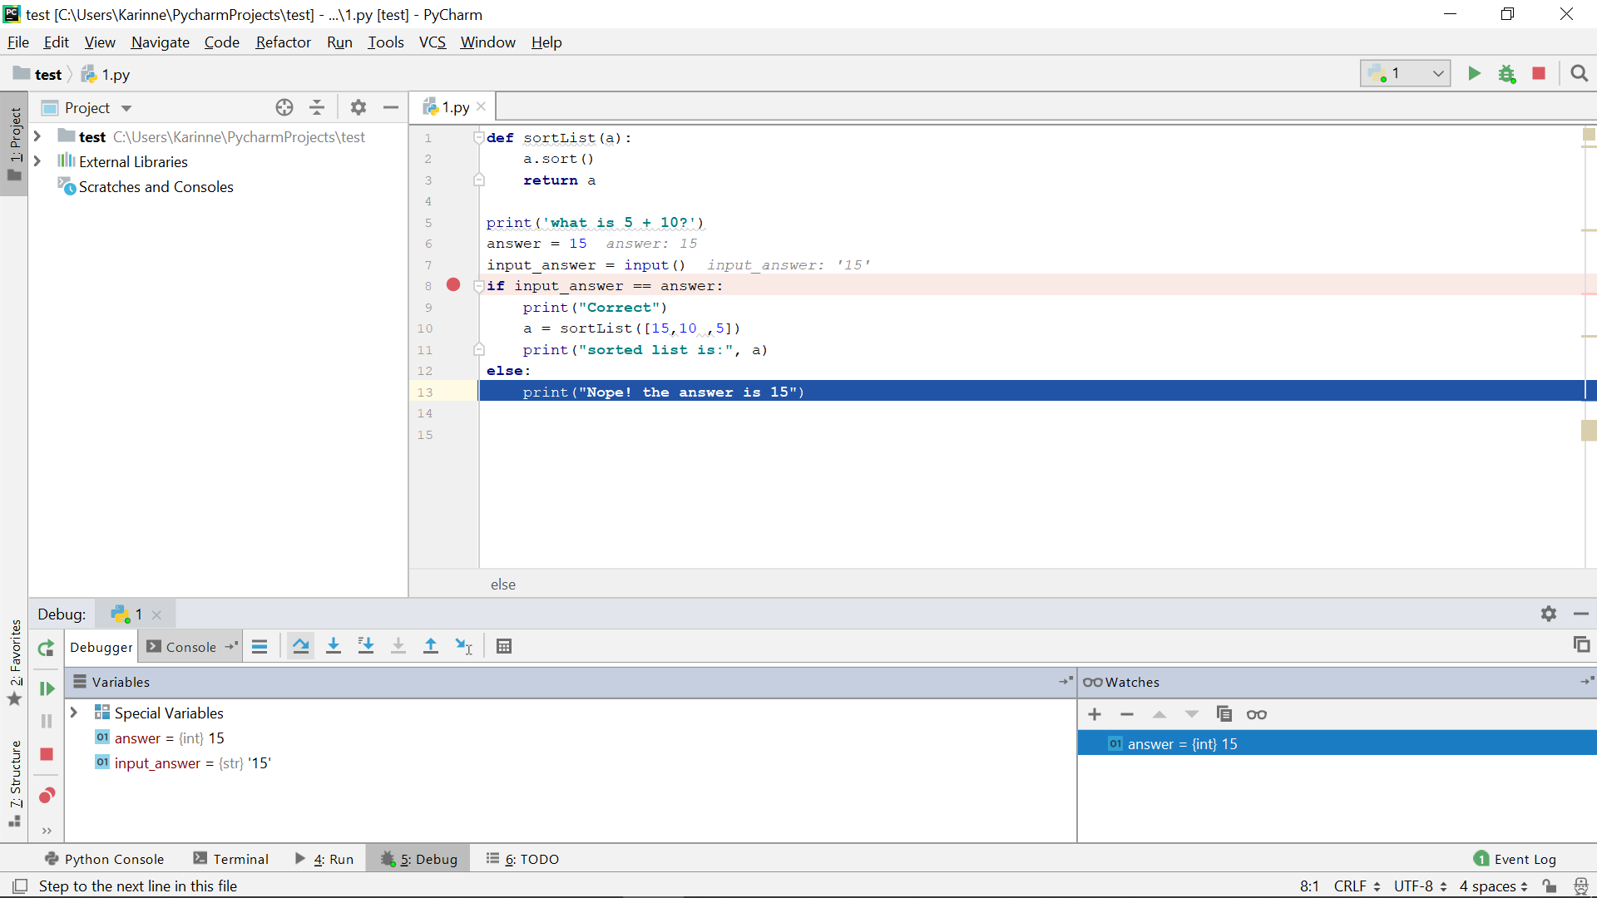
Step over brings us to the next line
We can now see our bug.
Types are not the same.

Slide 17
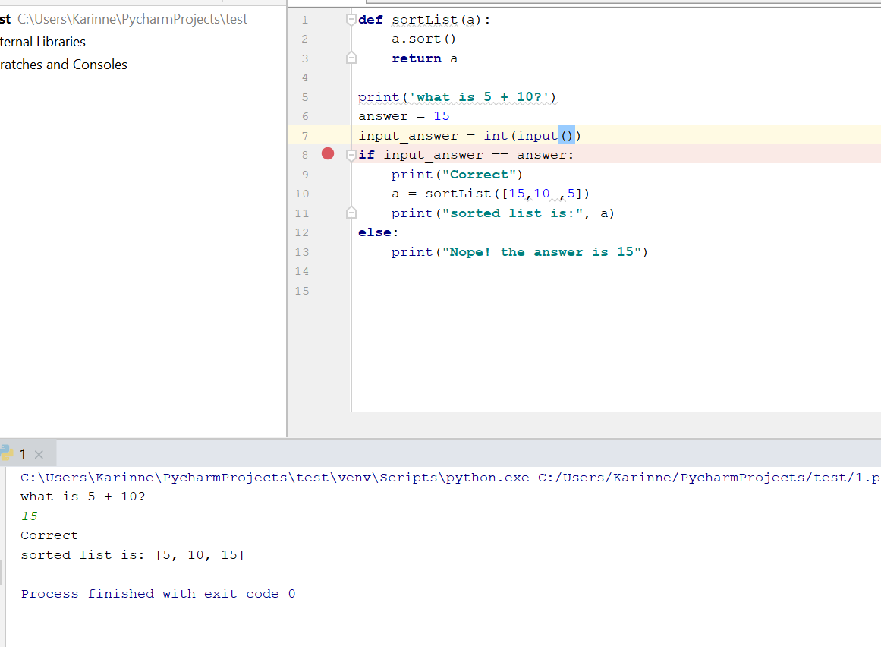
Now the code runs as we wanted it to.

Slide 18
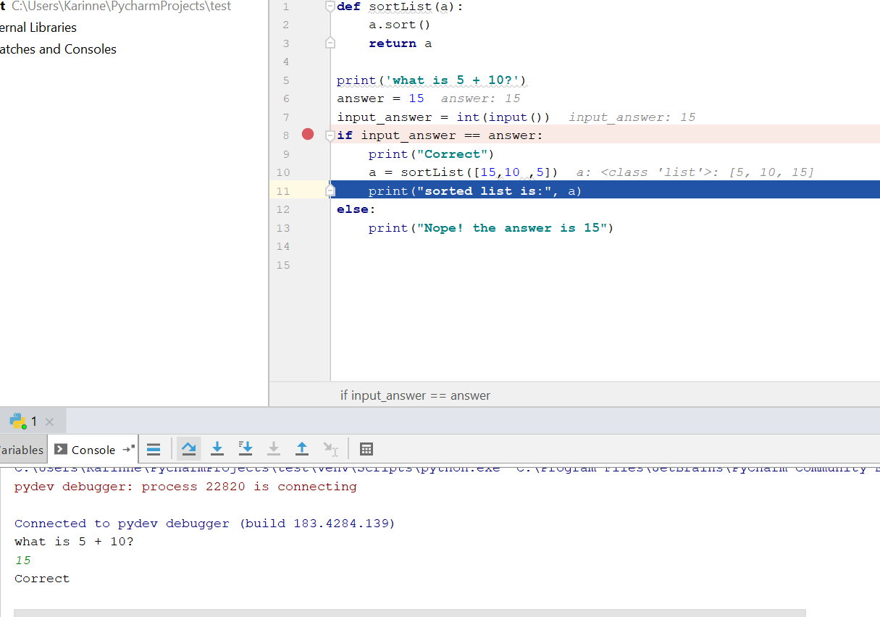
The difference between step over & step into
a is sorted
Step over steps to the next line Python will execute, skipping the methods referenced at the current execution point (if any).
Meaning we did not go into sortList function.
This is the situation after 3 step overs from break point.
Notice highlighted line was not printed yet.

Slide 19
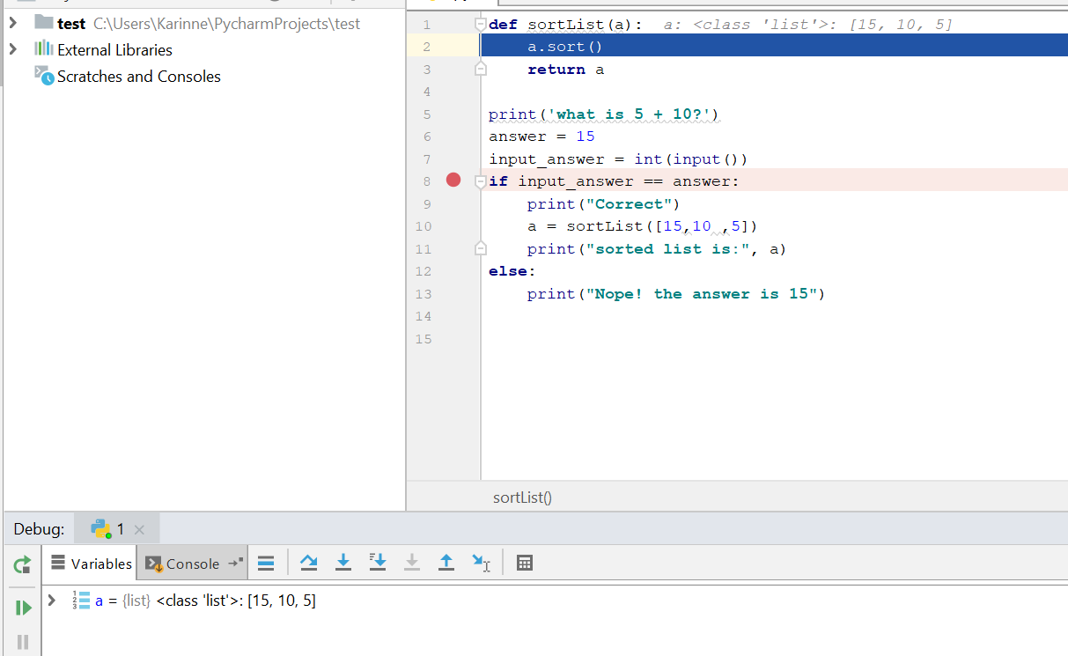
After 3 step inots we get to sortList function
Notice that all our main variables are not shown now, we only see local variables from sortList.
Step into

Slide 20
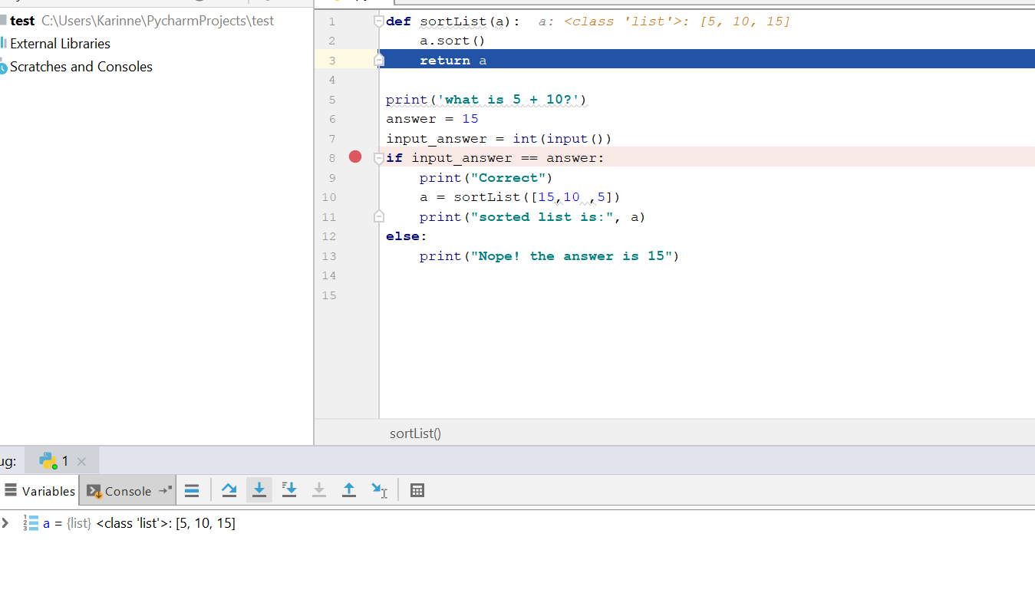
After another step a is sorted

Slide 21
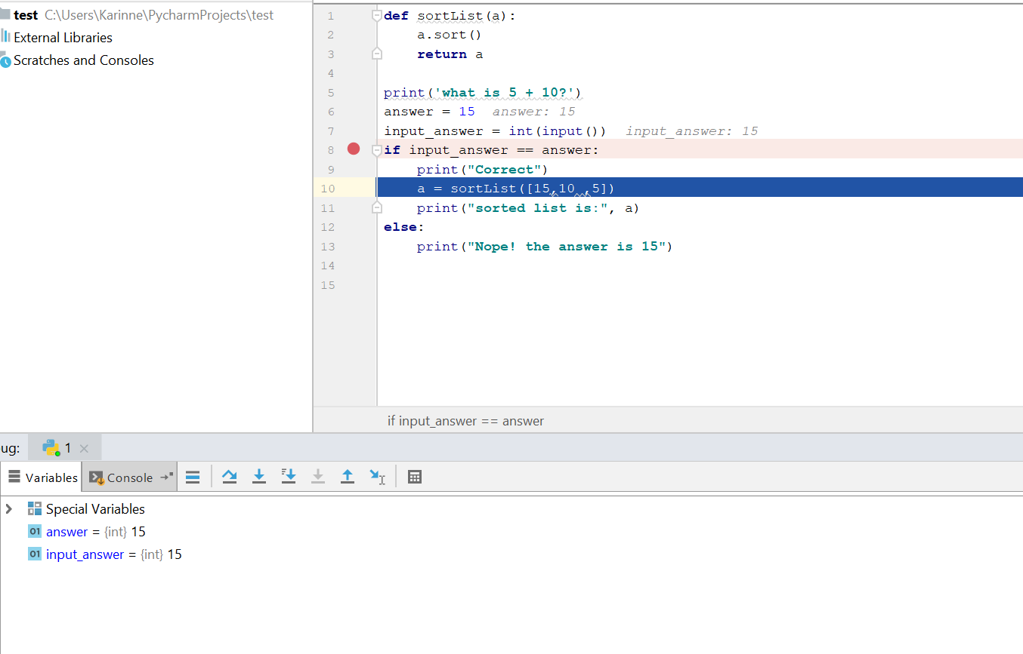
And after another one we are back to our main

Slide 22
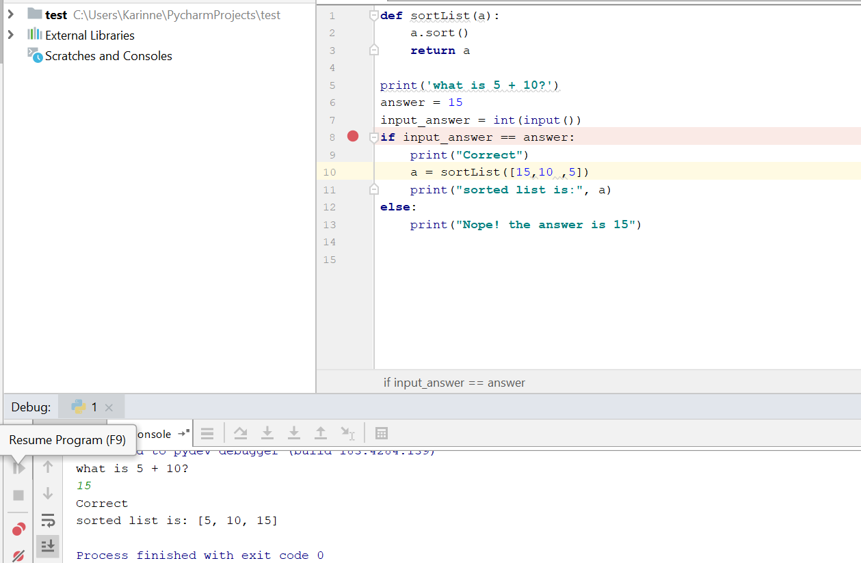
You can now use resume program to let the program run to the end

Slide 23
More information about debug tool can be found at https://www.jetbrains.com/help/pycharm/debug-tool-window.html

